Slide 1
Unit II Basics of Python Programming
1st Half till operators

Slide 2
Python Keywords
Keywords are reserved words and they cannot be used as names for identifiers or programmer defined variables.
The keywords are listed in the Keyword module and can be printed easily on python platform as shown below (in python shell)
Import keyword
Print(keyword.kwlist)

Slide 3
Python Keywords
Keyword | Description
and | A logical operator
as | To create an alias
assert | For debugging
break | To break out of a loop
class | To define a class
continue | To continue to the next iteration of a loop
def | To define a function
del | To delete an object
elif | Used in conditional statements, same as else if
else | Used in conditional statements
except | Used with exceptions, what to do when an exception occurs
FALSE | Boolean value, result of comparison operations
finally | Used with exceptions, a block of code that will be executed no matter if there is an exception or not
for | To create a for loop

Slide 4
Keyword | Description
from | To import specific parts of a module
global | To declare a global variable
if | To make a conditional statement
import | To import a module
in | To check if a value is present in a list, tuple, etc.
is | To test if two variables are equal
lambda | To create an anonymous function
None | Represents a null value
nonlocal | To declare a non-local variable
not | A logical operator
or | A logical operator
pass | A null statement, a statement that will do nothing
raise | To raise an exception

Slide 5
Keyword | Description
return | To exit a function and return a value
TRUE | Boolean value, result of comparison operations
try | To make a try...except statement
while | To create a while loop
with | Used to simplify exception handling
yield | To end a function, returns a generator

Slide 6
Python Variables
A Variable is a name that refers to a value stored in memory location. These are the containers for storing data values.
Python has no command for declaring a variable. A variable is created the moment you first assign a value to it.
Example
x = 5 y = "John" print(x) print(y)
Output : 5 John
Variables do not need to be declared with any particular type, and can even change type after they have been set.
Example
x = 4 # x is of type int x = "Sally" # x is now of type str print(x)
Output: Sally
Casting
If you want to specify the data type of a variable, this can be done with casting.
Example
x = str(3) # x will be '3' y = int(3) # y will be 3 z = float(3) # z will be 3.0
Output:3
3
3.0

Slide 7
Python Variables
Get the Type
You can get the data type of a variable with the type() function.
Example
x = 5 y = "John" print(type(x)) print(type(y))
Output
<class 'int'>
<class 'str’>
Single or Double Quotes?: String variables can be declared either by using single or double quotes.
Example
x = "John"
print(x)
#double quotes are the same as single quotes:
x = 'John'
print(x)
Output:
John
John

Slide 8
Python Variables
Case Sensitive: Variable names are case-sensitive.
Example:
a = 4 A = "Sally“
print(a)
print(A) #A will not overwrite a
Output:4 Sally

Slide 9
Python - Variable Names
Variable Names
A variable can have a short name (like x and y) or a more descriptive name (age, carname, total_volume). Rules for Python variables:A variable name must start with a letter or the underscore character
A variable name cannot start with a number
A variable name can only contain alpha-numeric characters and underscores (A-z, 0-9, and _ )
Variable names are case-sensitive (age, Age and AGE are three different variables)
A variable name cannot be any of the Python keywords.

Slide 10
Python - Variable Names
Example on Variable Names (Legal variable names) : myvar = "John" my_var = "John" _my_var = "John" myVar = "John" MYVAR = "John" myvar2 = "John" print(myvar) print(my_var) print(_my_var) print(myVar) print(MYVAR) print(myvar2) Output: John John John John John John | Example on Variable Names (Illegal variable names) : 2myvar = "John" my-var = "John" my var = "John" #This example will produce an error in the result

Slide 11
Python Variables
Remember that variable names are case-sensitive
Multi Words Variable Names:Variable names with more than one word can be difficult to read.There are several techniques you can use to make them more readable:
Camel Case: Each word, except the first, starts with a capital letter:
myVariableName = "John"
Pascal Case: Each word starts with a capital letter:
MyVariableName = "John“
Snake Case:Each word is separated by an underscore character:
my_variable_name = "John"

Slide 12
Python Variables - Assign Multiple Values
Many Values to Multiple Variables: Python allows you to assign values to multiple variables in one line:
x, y, z = "Orange", "Banana", "Cherry"
print(x)
print(y)
print(z)
Output: Orange
Banana
Cherry
Make sure the number of variables matches the number of values, or else you will get an error.
One Value to Multiple Variables & you can assign the same value to multiple variables in one line:
x = y = z = "Orange"
print(x)
print(y)
print(z)
Output: Orange Orange Orange

Slide 13
Python Variables (Contd..)
Unpack a Collection: If you have a collection of values in a list, tuple etc. Python allows you to extract the values into variables. This is called unpacking.
Example:
fruits = ["apple", "banana", "cherry"]
x, y, z = fruits
print(x)
print(y)
print(z)
Output: apple banana cherry

Slide 14
Python - Output Variables
Output Variables
The Python print() function is often used to output variables.
Example:
x = "Python is awesome"
print(x)
Output: Python is awesome
In the print() function, you output multiple variables, separated by a comma:
Example:
x = "Python"
y = "is"
z = "awesome"
print(x, y, z)
Output:
Python is awesome
You can also use the + operator to output multiple variables:
x = "Python "
y = "is "
z = "awesome"
print(x + y + z)
Output: Python is awesome
Note:Notice the space character after "Python " and "is ", without them the result would be "Pythonisawesome".

Slide 15
Python - Output Variables
For numbers, the + character works as a mathematical operator:
x = 5
y = 10
print(x + y)
Output:15
Note: In the print() function, when you try to combine a string and a number with the + operator, Python will give you an error:
Example
x = 5
y = "John"
print(x + y)
Output:TypeError: unsupported operand type(s) for +: 'int' and 'str’
The best way to output multiple variables in the print() function is to separate them with commas, which even support different data types:
x = 5
y = "John"
print(x, y)
Output: 5 John

Slide 16
Python - Global Variables
Variables that are created outside of a function (as in all of the examples above) are known as global variables. Global variables can be used by everyone, both inside of functions and outside.
Example: Create a variable outside of a function, and use it inside the function
x = "awesome"
def myfunc():
print("Python is " + x)
myfunc()
Output: Python is awesome
If you create a variable with the same name inside a function, this variable will be local, and can only be used inside the function. The global variable with the same name will remain as it was, global and with the original value.
Example: Create a variable inside a function, with the same name as the global variable
x = "awesome"
def myfunc():
x = "fantastic"
print("Python is " + x)
myfunc()
print("Python is " + x)
Output: Python is fantastic Python is awesome

Slide 17
Summary on Python variables
A python variable must begin with a letter (a-z, A-Z) or underscore(_) followed by letters,numbers or underscores
Python variables are case sensitive(Variable name sum and Sum are two different variables).
Variables can be assigned values with the assignment statement. Foe Eg.: >>>str = ‘Hello’!
>>>sum = 0
>>>term = 0.00025
The variable str holds a string ‘Hello’!, where as the variable sum holds an integer value() and the variable term holds a floating point value of 0.000025.
It is observed that no data type was specified while specifying the variables. This is because python decides the type of variable based upon the value that holds it at run time.This is known as Dynamic Type interpretation.

Slide 18
Comments
The comments in Python begins with pound (hash tag) # symbol. The comments in python is a natural language that tells the user/reader what a section of code does.
#Compute the simple interest
Simple_interest = (p*t*r)/100

Slide 19
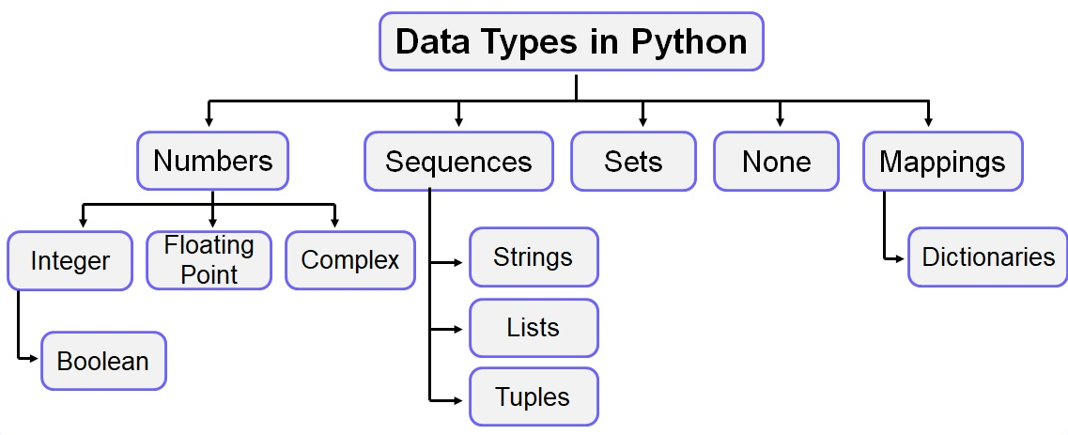
Python Data Types

Slide 20
Python Data Types
Built-in Data Types: In programming, data type is an important concept. Variables can store data of different types, and different types can do different things.Python has the following data types built-in by default, in these categories:
Text Type: str
Numeric Types: int, float, complex
Sequence Types: list, tuple, range
Mapping Type: dict
Set Types: set, frozenset
Boolean Type: bool
Binary Types: bytes, bytearray, memoryview
None Type: NoneType

Slide 21
Python Data Types
Getting the Data Type
You can get the data type of any object by using the type() function:
x = 1j
#display x:
print(x)
#display the data type of x:
print(type(x))
Output: lj <class 'complex'>
Example:
x = 5
print(type(x))
Output: <class 'int'>
x = 20.5
#display x:
print(x)
#display the data type of x:
print(type(x))
Output: 20.5 <class 'float'>

Slide 22
x = ["apple", "banana", "cherry"]
#display x:
print(x)
#display the data type of x:
print(type(x))
Output: ['apple', 'banana', 'cherry'] <class 'list'
x = range(6)
#display x:
print(x)
#display the data type of x:
print(type(x))
Output:
x = ("apple", "banana", "cherry")
#display x:
print(x)
#display the data type of x:
print(type(x))
Output:
('apple', 'banana', 'cherry') <class 'tuple'>

Slide 23
Example | Data Type
x = "Hello World" | str
x = 20 | int
x = 20.5 | float
x = 1j | complex
x = ["apple", "banana", "cherry"] | list
x = ("apple", "banana", "cherry") | tuple
x = range(6) | range
x = {"name" : "John", "age" : 36} | dict
x = {"apple", "banana", "cherry"} | set
x = frozenset({"apple", "banana", "cherry"}) | frozenset
x = True | bool
x = b"Hello" | bytes
x = bytearray(5) | bytearray
x = memoryview(bytes(5)) | memoryview
x = None | NoneType

Slide 24
Python Data Types
Setting the Specific Data Type: If you want to specify the data type, you can use the following constructor functions:
Example | Data Type
x = str("Hello World") | str
x = int(20) | int
x = float(20.5) | float
x = complex(1j) | complex
x = list(("apple", "banana", "cherry")) | list
x = tuple(("apple", "banana", "cherry")) | tuple
x = range(6) | range
x = dict(name="John", age=36) | dict
x = set(("apple", "banana", "cherry")) | set
x = frozenset(("apple", "banana", "cherry")) | frozenset
x = bool(5) | bool
x = bytes(5) | bytes
x = bytearray(5) | bytearray
x = memoryview(bytes(5)) | memoryview

Slide 25
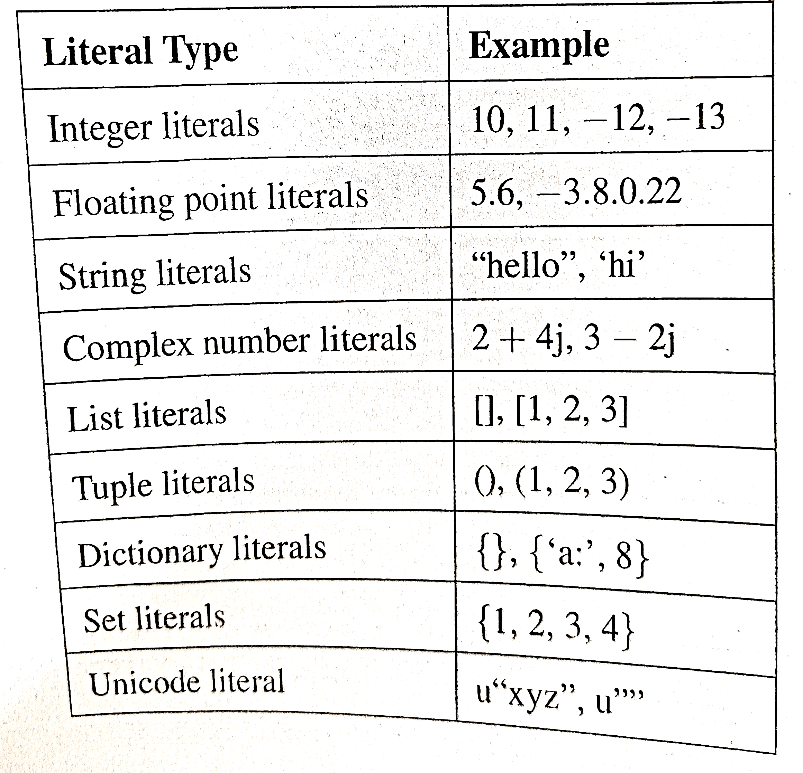
Python Literals
A literal is a notation that represents a fixed value.
Numeric Literals: They consists of digits (0-9) with an optional (+ or -) possibly a decimal point.

Slide 26
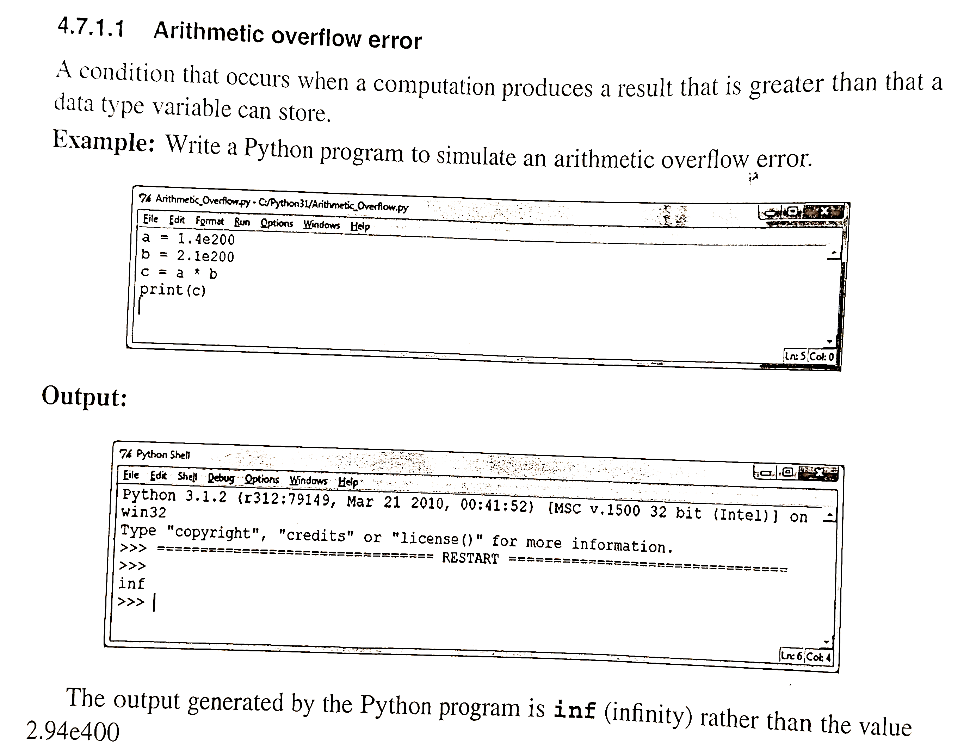

Slide 27
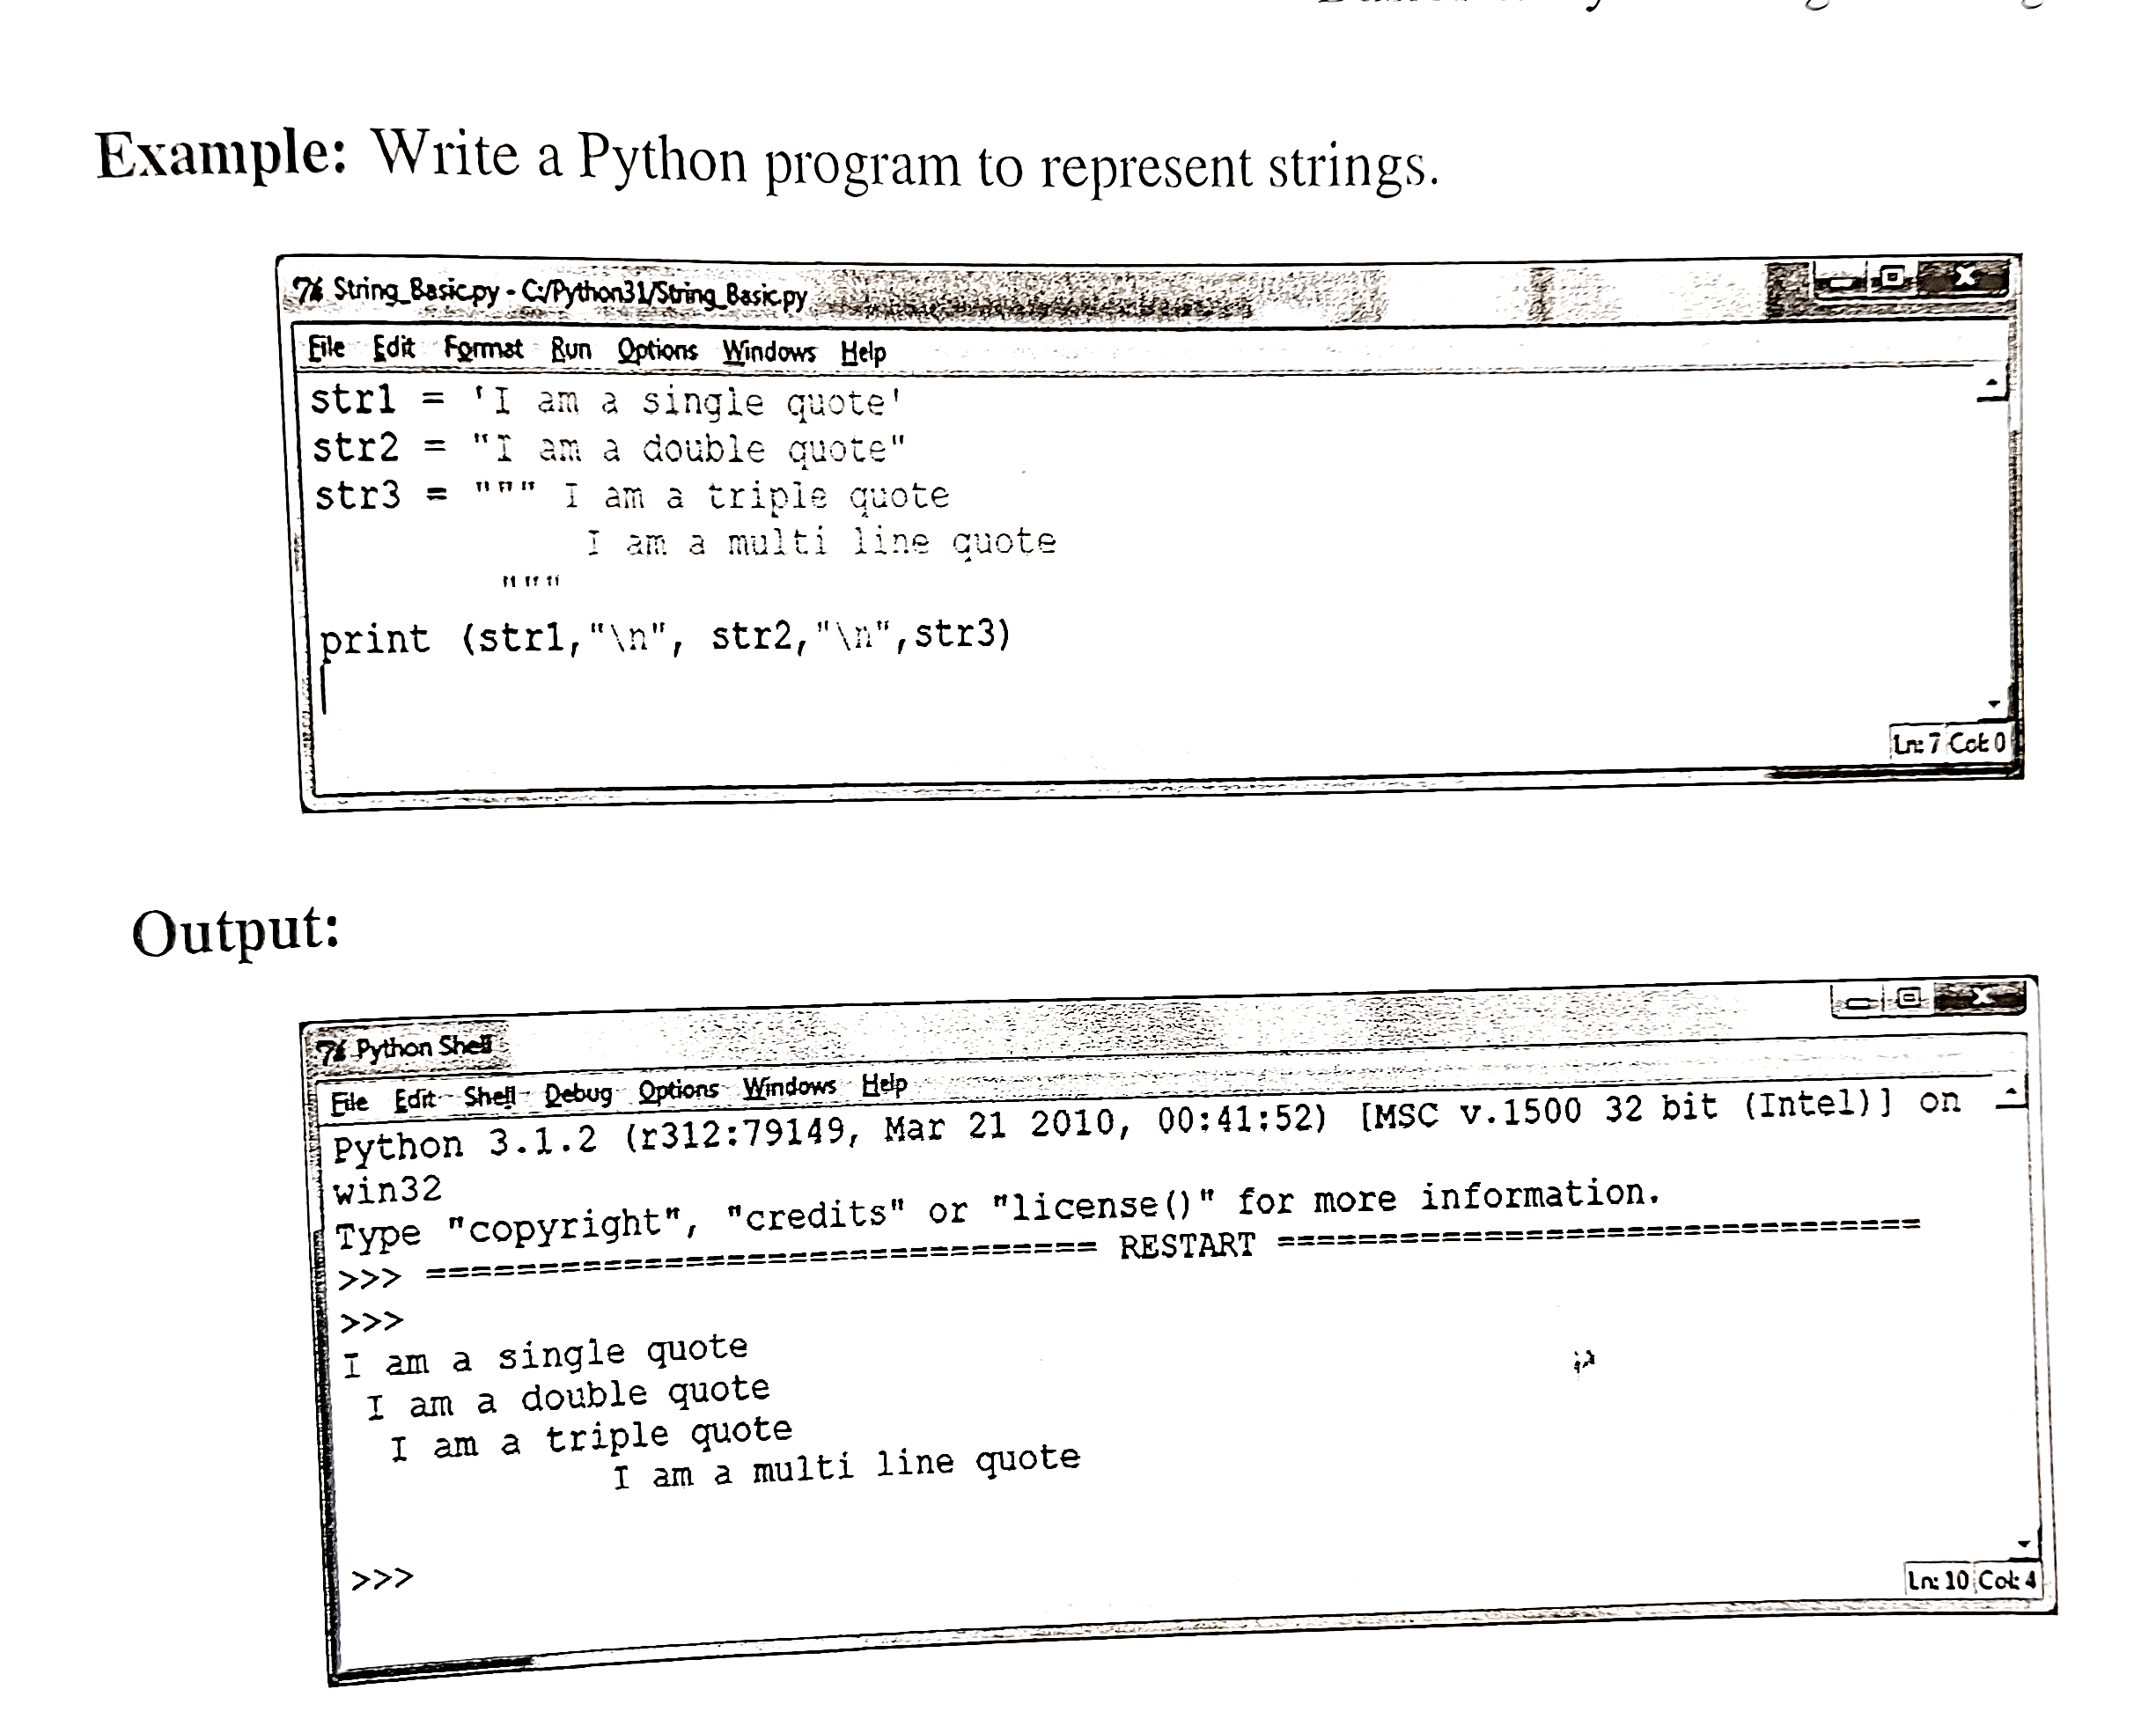

Slide 28
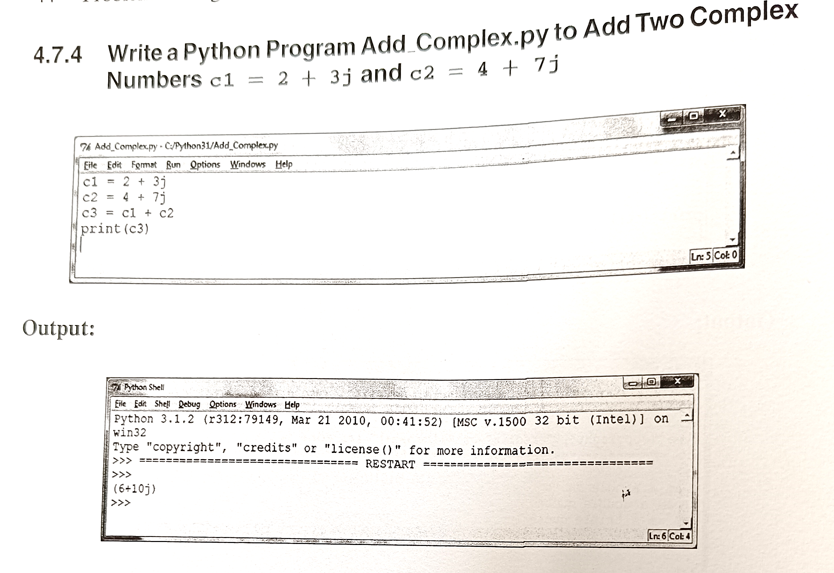

Slide 29
Python Operators
Operators are used to perform operations on variables and values.
In the example below, we use the + operator to add together two values:
print(10 + 5)
Python divides the operators in the following groups:
Arithmetic operators
Assignment operators
Comparison operators
Logical operators
Identity operators
Membership operators
Bitwise operators
An operator is a special symbol that helps the user to write arithmetic or logical computations. The operand specifies the data that is to be manipulated by the operator
+ 5
Operand
Operand

Slide 30
Python Arithmetic Operators
Arithmetic operators are used with numeric values to perform common mathematical operations:
Operator | Name | Example
+ | Addition | x + y
- | Subtraction | x - y
* | Multiplication | x * y
/ | Division | x / y
% | Modulus | x % y
** | Exponentiation | x ** y
// | Floor division | x // y
Example:
print(10 + 5)
output:15
x = 8
y = 2
print(x % y)
Output:0

Slide 31
Python Assignment Operators
Assignment operators are used to assign values to variables:
Operator | Example | Same As
= | x = 5 | x = 5
+= | x += 3 | x = x + 3
-= | x -= 3 | x = x - 3
*= | x *= 3 | x = x * 3
/= | x /= 3 | x = x / 3
%= | x %= 3 | x = x % 3
//= | x //= 3 | x = x // 3
**= | x **= 3 | x = x ** 3
&= | x &= 3 | x = x & 3
|= | x |= 3 | x = x | 3
^= | x ^= 3 | x = x ^ 3
>>= | x >>= 3 | x = x >> 3
<<= | x <<= 3 | x = x << 3
Example:
x = 5
print(x)
x = 5
x%=3
print(x)
output:2

Slide 32
Python Relational (Comparison) Operators
Comparison operators are used to compare two values:
Operator | Name | Example
== | Equal | x == y
!= | Not equal | x != y
> | Greater than | x > y
< | Less than | x < y
>= | Greater than or equal to | x >= y
<= | Less than or equal to | x <= y
Example
x = 5
y = 3
print(x != y)
# returns True because 5 is not equal to 3

Slide 33
Python Logical Operators
Logical operators are used to combine conditional statements:
Operator | Description | Example
and | Returns True if both statements are true | x < 5 and x < 10
or | Returns True if one of the statements is true | x < 5 or x < 4
not | Reverse the result, returns False if the result is true | not(x < 5 and x < 10)
x = 5
print(x > 3 and x < 10)
# returns True because 5 is greater than 3 AND 5 is less than 10
Output: True

Slide 34
Python Identity Operators
Identity operators are used to compare the objects, not if they are equal, but if they are actually the same object, with the same memory location:
Example:
x = ["apple", "banana"]
y = ["apple", "banana"]
z = x
print(x is not z)
# returns False because z is the same object as x
print(x is not y)
# returns True because x is not the same object as y, even if they have the same content
print(x != y)
# to demonstrate the difference betweeen "is not" and "!=": this comparison returns False because x is equal to y
Output:False
True
False
Operator | Description | Example
is | Returns True if both variables are the same object | x is y
is not | Returns True if both variables are not the same object | x is not y

Slide 35
Operator Precedence
Operator precedence describes the order in which operations are performed.
Parentheses has the highest precedence, meaning that expressions inside parentheses must be evaluated first:
print((8 + 3) - (6 + 3))
"""
Parenthesis have the highest precedence, and need to be evaluated first.
The calculation above reads 11 - 9 = 0
"""
output: 2

Slide 36
Operator Precedence
Multiplication * has higher precedence than addition +, and therefor multiplications are evaluated before additions:
print(100 + 5 * 3)
"""
Multiplication has higher precedence than addition, and needs to be evaluated first.
The calculation above reads 100 + 15 = 115
"""
output:115
If two operators have the same precedence, the expression is evaluated from left to right.
Example
Addition + and subtraction - has the same precedence, and therefor we evaluate the expression from left to right:
print(5 + 4 - 7 + 3)
"""Additions and subtractions have the same precedence, and we need to calculate from left to right.
The calculation above reads:
5 + 4 = 9
9 - 7 = 2
2 + 3 = 5
"""
output=5

Slide 37
Lab for Unit 2 1st half till operators

Slide 38
Write a program to calculate the area of a rectangle when input values are fixed
Length = 10
breadth = 20
print(‘ Length = ‘,length,’ Breadth = ‘,breadth)
area = length * breadth
print(‘ Area of Rectangle is = ‘,area)
Output : Length = 10 Breadth = 20
Area of Rectangle is = 200

Slide 39
Write a python program to exchange the values of two variables
a=10
b=20
print(“The original value of a is: “,a, “b is:”,b)
(a,b)=(b,a)
print(“The exchanged value of a is: “,a, “b is: “, b)
Output
The original value of a is: 10 b is:20
The exchanged value of a is: 20 b is:10

Slide 40
Python program to compute distance between two points
import math
print(“Enter the details of P1(x1,y1) and P2(x2,y2)”)
x1=int(input(“x1: “))
y1=int(input(“y1: “))
x2=int(input(“x2: “))
y2=int(input(“y2: “))
dist=math.sqrt((x2-x1)**2+(y2-y1)**2)
print(“The distance between two points is: “, dist)
Output:
x1: 3
y1: 4
x2: 7
y2: 7
The distance between two points is: 5.0

